Slide 1
Software System Modeling

Slide 2

Agenda
Behavioral design patterns

Slide 3
Resources
Head First Design Patterns
https://refactoring.guru/design-patterns
https://mermaid-js.github.io/ https://lucid.app/ - class diagrams

Slide 4
Behavioral Design patterns

Slide 5
Behavioral design patterns are concerned with algorithms and the assignment of responsibilities between objects.

Slide 6
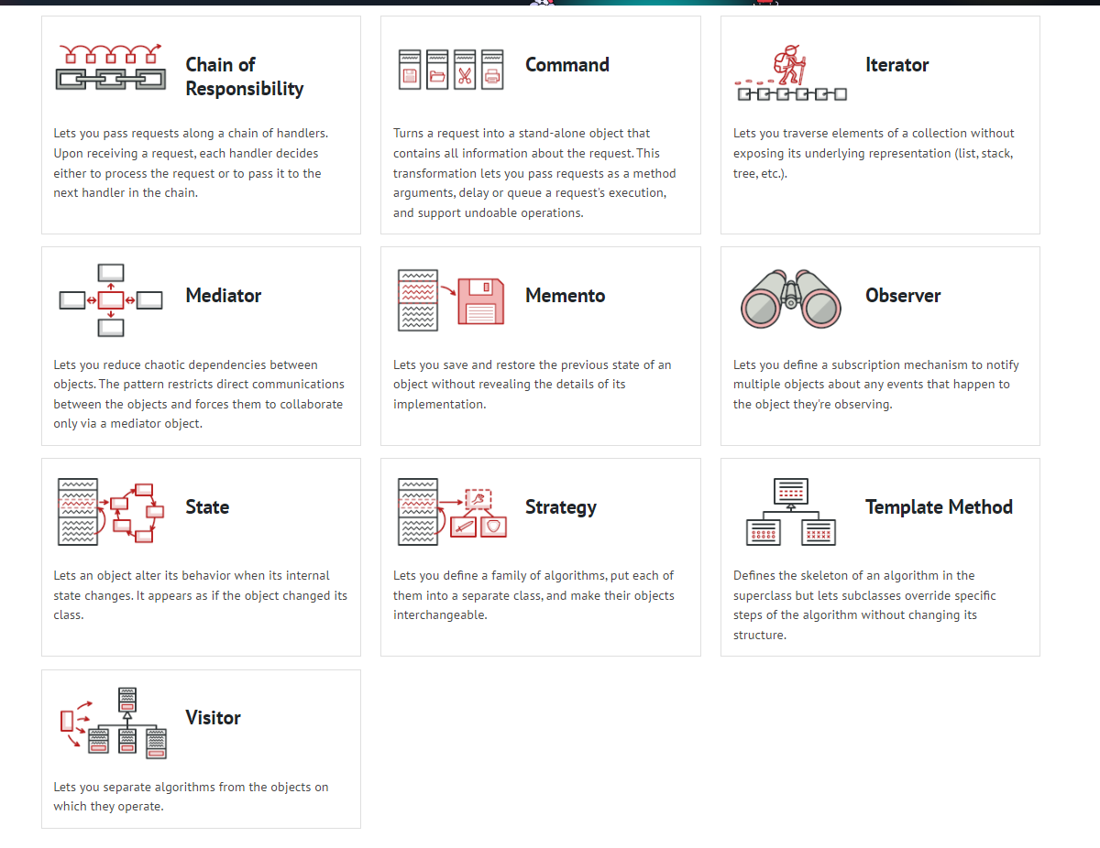

Slide 7
Strategy
Strategy is a behavioral design pattern that lets you define a family of algorithms, put each of them into a separate class, and make their objects interchangeable.

Slide 8
Problem
Imagine that you’re building a travelling app. Initially you provided the possibility to make a rout of tourist attractions, visited by car
At some point, you receive multiple requests to extend the app and allow the possibility to create routes for public transport or walking routes.
How should we structure our application so that it’s easy to add more routing algorithms?

Slide 9
Solution
The Strategy pattern suggests that you take a class that does something specific in a lot of different ways and extract all these algorithms into separate classes called strategies.
The original class, called context, must have a field for storing a reference to one of the strategies. The context delegates the work to a linked strategy object instead of executing it on its own.

Slide 10
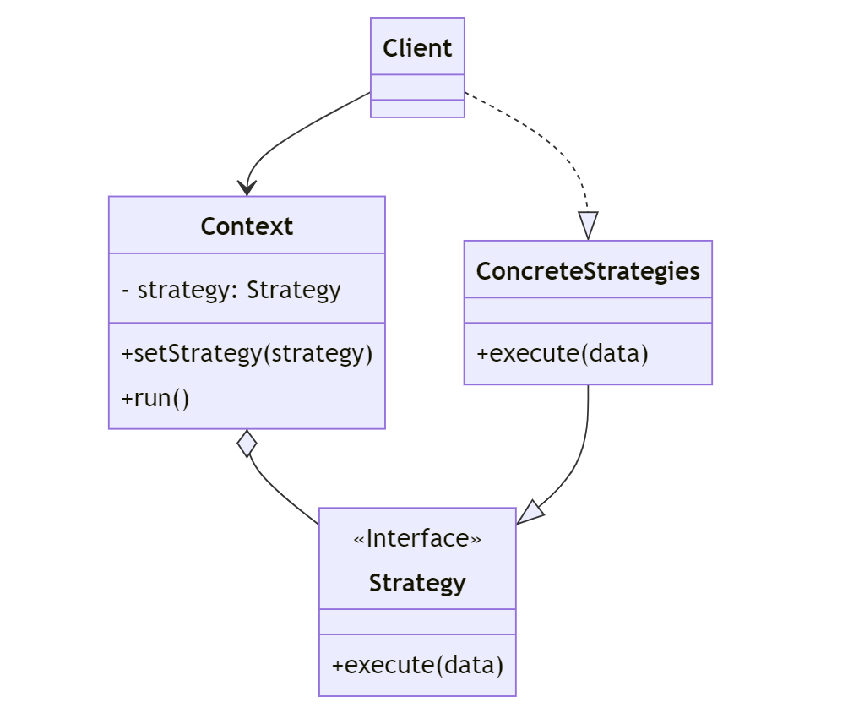

Slide 11
Pros
Cons
You can swap algorithms used inside an object at runtime.
You can isolate the implementation details of an algorithm from the code that uses it.
You can replace inheritance with composition.
Open/Closed Principle. You can introduce new strategies without having to change the context.
If you only have a couple of algorithms and they rarely change, there’s no real reason to overcomplicate the program with new classes and interfaces that come along with the pattern.
Clients must be aware of the differences between strategies to be able to select a proper one.
A lot of modern programming languages have functional type support that lets you implement different versions of an algorithm inside a set of anonymous functions. Then you could use these functions exactly as you’d have used the strategy objects, but without bloating your code with extra classes and interfaces.

Slide 12
Iterator
Iterator is a behavioral design pattern that lets you traverse elements of a collection without exposing its underlying representation (list, stack, tree, etc.).

Slide 13
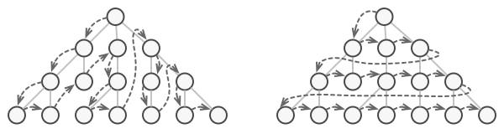
Problem
Most collections store their elements in simple lists. However, some of them are based on stacks, trees, graphs and other complex data structures.
This may sound like an easy job if you have a collection based on a list. You just loop over all of the elements. But how do you sequentially traverse elements of a complex data structure, such as a tree?

Slide 14
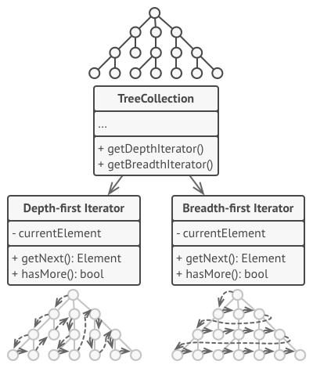
Solution
The main idea of the Iterator pattern is to extract the traversal behavior of a collection into a separate object called an iterator.
Usually, iterators provide one primary method for fetching elements of the collection. The client can keep running this method until it doesn’t return anything, which means that the iterator has traversed all of the elements.

Slide 15
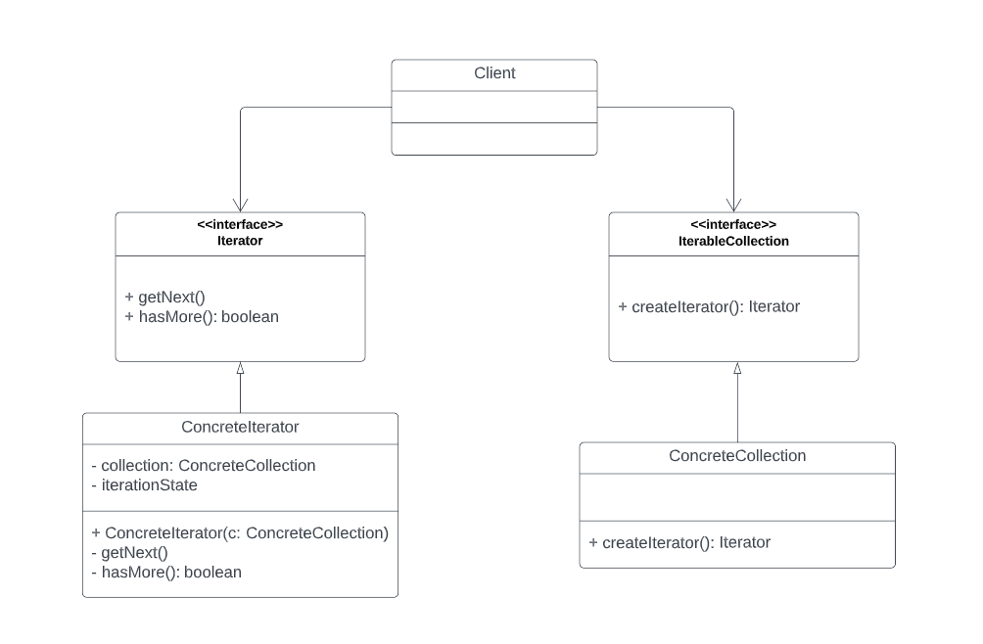

Slide 16
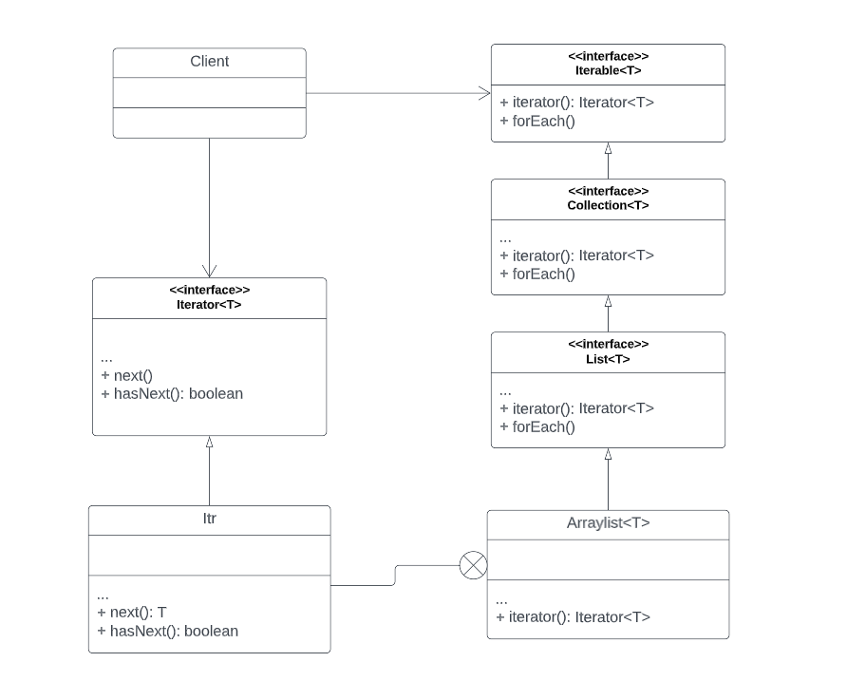
Java Iterator implementation

Slide 17
Pros
Cons
Single Responsibility Principle. You can clean up the client code and the collections by extracting bulky traversal algorithms into separate classes.
Open/Closed Principle. You can implement new types of collections and iterators and pass them to existing code without breaking anything.
You can iterate over the same collection in parallel because each iterator object contains its own iteration state.
For the same reason, you can delay an iteration and continue it when needed.
Applying the pattern can be an overkill if your app only works with simple collections.
Using an iterator may be less efficient than going through elements of some specialized collections directly.

Slide 18
Command
Command is a behavioral design pattern that turns a request into a stand-alone object that contains all information about the request. This transformation lets you pass requests as a method arguments, delay or queue a request’s execution, and support undoable operations.

Slide 19
Problem
Imagine that you’re working on a new text-editor app. Your need to create a toolbar with a bunch of buttons for various operations of the editor. You create Button class that can be used for buttons on the toolbar, as well as for generic buttons in various dialogs.
The simplest solution is to create tons of subclasses for each place where the button is used. These subclasses would contain the code that would have to be executed on a button click.
Before long, you realize that this approach is deeply flawed. First, you have an enormous number of subclasses, and that would be okay if you weren’t risking breaking the code in these subclasses each time you modify the base Button class. Put simply, your GUI code has become awkwardly dependent on the volatile code of the business logic.

Slide 20
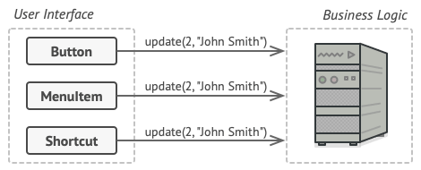
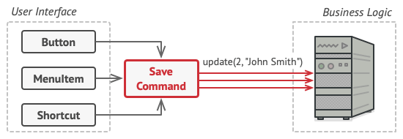
Solution
In the described problem, the code might look like a GUI object calls a method of a business logic object, passing it some arguments. This process is usually described as one object sending another a request.
The Command pattern suggests that GUI objects shouldn’t send these requests directly. Instead, you should extract all the request details, such as the object being called, the name of the method and the list of arguments into a separate command class with a single method that triggers this request.

Slide 21
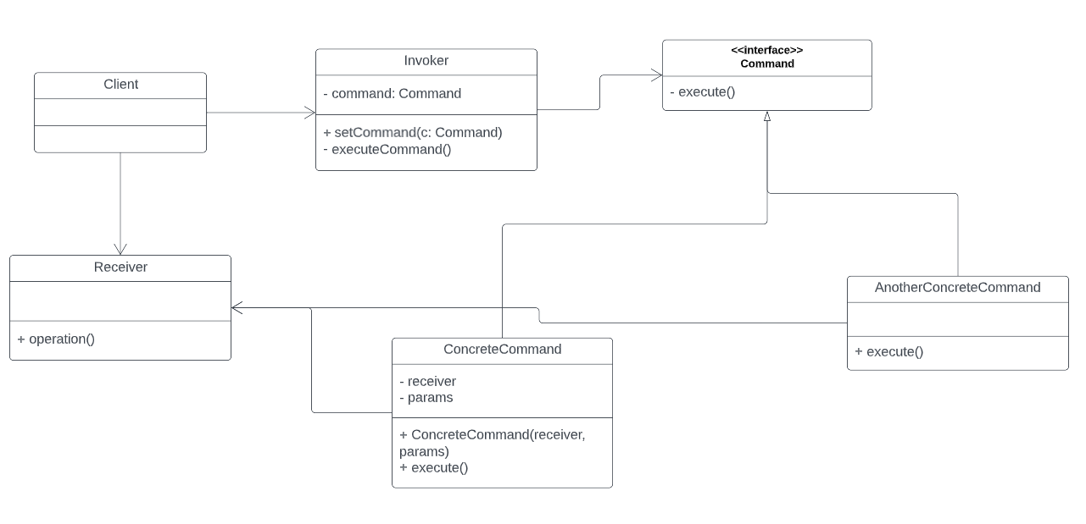

Slide 22
Pros
Cons
Single Responsibility Principle. You can decouple classes that invoke operations from classes that perform these operations.
Open/Closed Principle. You can introduce new commands into the app without breaking existing client code.
You can implement undo/redo.
You can implement deferred execution of operations.
You can assemble a set of simple commands into a complex one.
The code may become more complicated since you’re introducing a whole new layer between senders and receivers.

Slide 23
observer
Observer is a behavioral design pattern that lets you define a subscription mechanism to notify multiple objects about any events that happen to the object they’re observing.

Slide 24
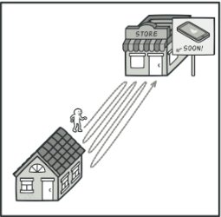
Problem
Imagine that you have two types of objects: a Customer and a Store. The customer is very interested in a particular brand of product (say, it’s a new model of the iPhone) which should become available in the store very soon. In order to be sure that he gets the new iPhone, customer visits the store every day. He soon finds out that this isn’t very effective.
Thinking of Customer and Store as two applications, how to solve the issue of having a lot of unneeded calls?

Slide 25
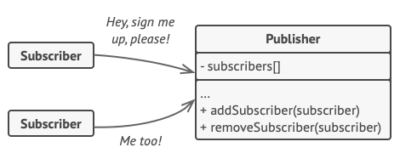
Solution
The Observer pattern suggests that you add a subscription mechanism to the publisher class so individual objects can subscribe to or unsubscribe from a stream of events coming from that publisher.
In reality, this mechanism consists of 1) an array field for storing a list of references to subscriber objects and 2) several public methods which allow adding subscribers to and removing them from that list.

Slide 26
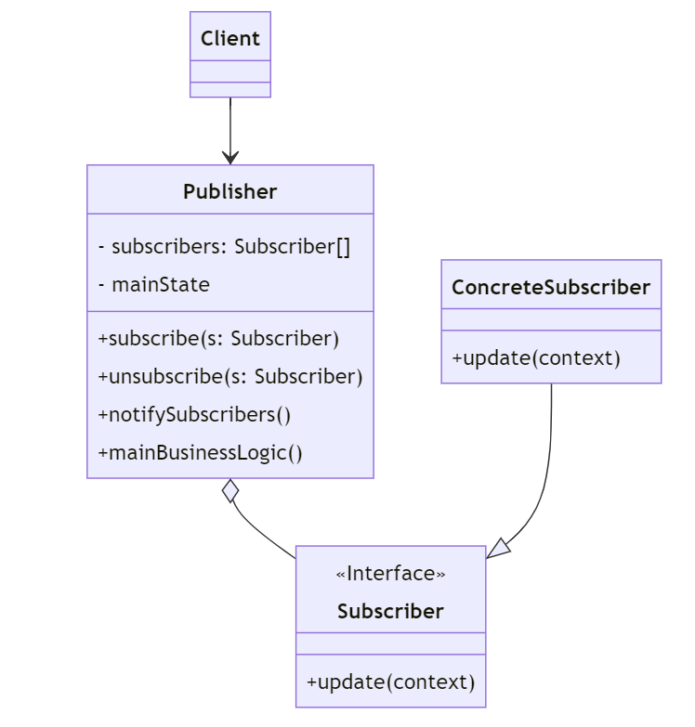

Slide 27
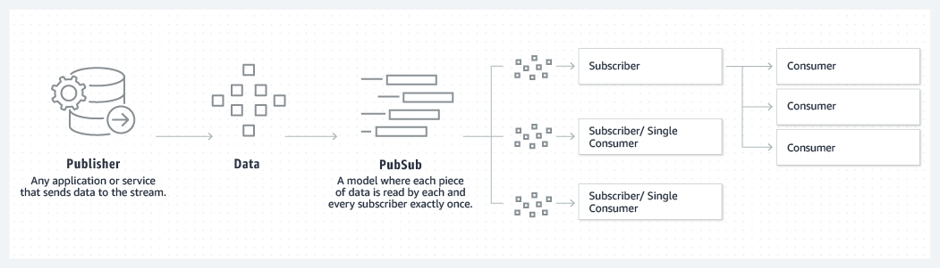

Slide 28
Pros
Cons
Open/Closed Principle. You can introduce new subscriber classes without having to change the publisher’s code (and vice versa if there’s a publisher interface).
You can establish relations between objects at runtime.
Subscribers are notified in random order.

Slide 29
Chain of Responsibility
Chain of Responsibility is a behavioral design pattern that lets you pass requests along a chain of handlers. Upon receiving a request, each handler decides either to process the request or to pass it to the next handler in the chain.

Slide 30
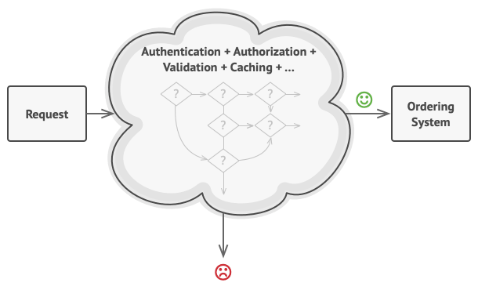
Problem
Imagine that you’re working on an online ordering system. You want to restrict access to the system so only authenticated users can create orders. Also, users who have administrative permissions must have full access to all orders.
During the next few months, you implemented several more of those sequential checks.
One of your colleagues suggested that it’s unsafe to pass raw data straight to the ordering system. You added an extra validation step to sanitize the data in a request.
Someone else suggested that you could speed up the system by returning cached results on repeated requests containing the same data. Hence, you added another check which lets the request pass through to the system only if there’s no suitable cached response.

Slide 31
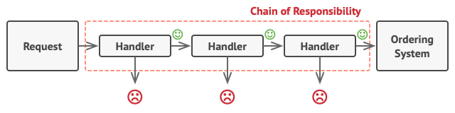
Solution
Like many other behavioral design patterns, the Chain of Responsibility relies on transforming behaviors into stand-alone objects called handlers. In our case, each check should be extracted to its own class with a single method that performs the check. The request, along with its data, is passed to this method as an argument.

Slide 32
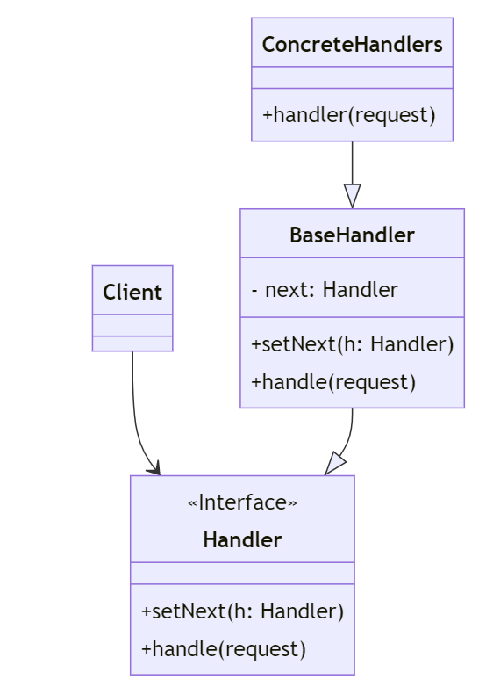

Slide 33
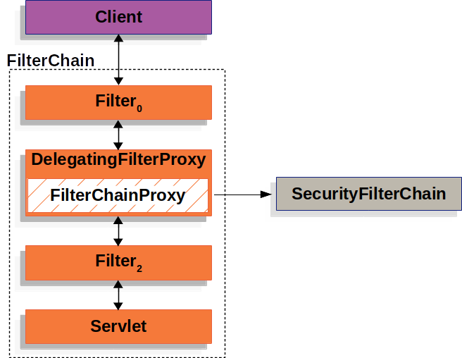
Filters in Spring Security
https://docs.spring.io/spring-security/reference/servlet/architecture.html

Slide 34
Pros
Cons
You can control the order of request handling.
Single Responsibility Principle. You can decouple classes that invoke operations from classes that perform operations.
Open/Closed Principle. You can introduce new handlers into the app without breaking the existing client code.
Some requests may end up unhandled.

